Slide 1

HIGH STEP-UP NON-ISOLATED ZVS/ZCS DC-DC CONVERTER FOR PHOTOVOLTAIC THIN-FILM MODULE APPLICATIONS
GURU NANAK INSTITUTE OF TECHNOLOGY
(Approved by AICTE – Affiliated to JNTU Hyderabad)
College Code: GNIT
By
G. Sai Ravalika 17831A0214
K. Tarun Teja 17831A0219
U. Shravanachary 18835A0216
Under the guidance of
Mr. N. Praneeth (Asst. Prof)
Department of
Electrical and Electronics Engineering

Slide 2
CONTENTS
Abstract
Introduction
Project Description
Modeling Of Proposed Theory
Simulation
Simulation Results
Conclusion

Slide 3
ABSTRACT
This presentation proposes a novel high step-up non-isolated dc-dc converter based on the classical synchronous Buck converter with coupled inductor and voltage multiplier techniques. Besides reducing the voltage stress on the active switches, the proposed converter also requires a coupled inductor with lower core-window product, allowing the use of a smaller magnetic device. The resonant operation mode of the proposed converter enables zero-voltage-switching (ZVS) turn-on of active switches and zero-current-switching (ZCS) turn-off of diodes, which increases its efficiency. Experimental results show that the maximum obtained efficiency is nearly 98.0%

Slide 4
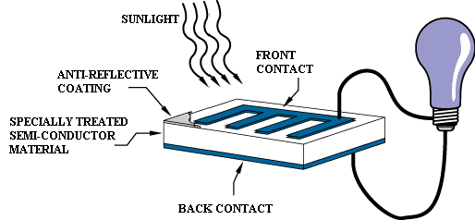
INTRODUCTION
The photovoltaic (PV) grid-connected power system in the residential applications is becoming a fast growing segment in the PV market due to the shortage of the fossil fuel energy and the great environmental pollution.
Despite the reduction in the percentage of global annual production in the last years, the thin-film technology still constitutes an important portion of the photovoltaic (PV) market.

Slide 5
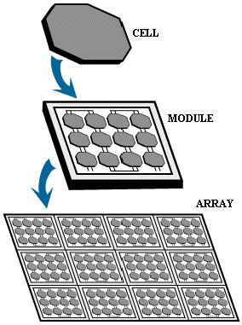
SOLAR CELL

Slide 6
ELECTRICAL CONNECTION OF THE CELLS
SERIES CONNECTION
PARALLEL CONNECTION

Slide 7
PROJECT DESCRIPTION
The proposed converter also requires a coupled inductor with lower core-window product, allowing the use of a smaller magnetic device. The resonant operation mode of the proposed converter enables zero-voltage-switching (ZVS) turn-on of active switches and zero-current switching (ZCS) turn-off of diodes, which increases its efficiency.
A dc-dc converter with high step-up gain is used to adapt the low PV module voltage to the required dc bus voltage (380~400 V) of the dc-ac converter employed for ac utility (208~240 V) connection. Such high step-up dc-dc converter can be isolated or non-isolated, however, the non-isolated ones are capable of achieving a higher level of efficiency.

Slide 8
The maximum power point (MPP) voltages of thin-film modules range from 40 to 100 V
Modules name
• Photovoltaic technology
• DC-DC converter
• Soft switching condition
The solar cell is the elementary building block of the photovoltaic technology. Solar cells are made of semiconductor materials, such as silicon.
The requirements of a SMPS and various types of DC-DC converters (isolated and non-isolated). High frequency transformer provides electrical isolation in SMPS.

Slide 9
MODELING OF PROPOSED THEORY
The switching model of the proposed converter
The couple inductor is represented by an ideal transformer with a magnetizing inductor Lm and a small leakage inductor Lk in the primary side.
Vi represents the PV thin-film module equivalent voltage.
S1 and S2 are the active switches, D1 and D2 are the diodes of the voltage multiplier cells.
Do is the output diode and Cb is the Buck capacitor that resonates with the leakage inductor.
C1 and C2 are the capacitors of the volt- age multiplier cells.
Co is the output capacitor and Ro is the resistive load.

Slide 10
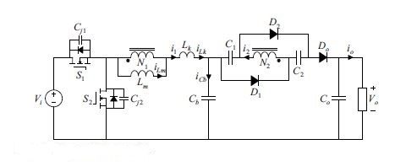
assumptions are made for the operating analysis:
The S1 and S2 are ideal MOSFETs with body diodes and equivalent parasitic junction capacitors Cj1 and Cj2.The other devices are ideal.
capacitors C1, C2, and Co are large enough that their voltages can be considered constant.
The turns ratio n of the coupled inductor is defined as n=N2/N1, where N1 and N2 are, respectively, the number of turns in the primary and secondary windings.

Slide 11
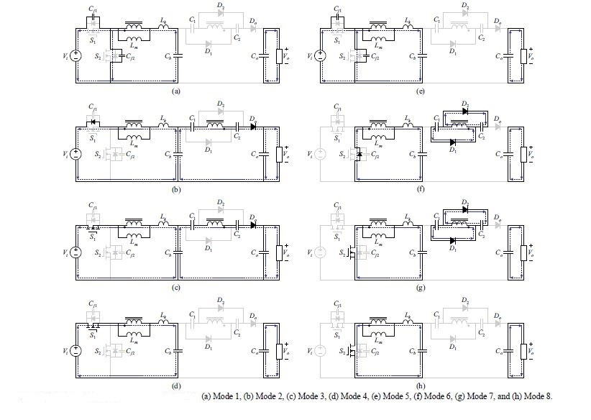
MODES OF OPERATION
The operating modes are as follow
Mode 1:The switch S2 is turned off. Thus, iLm starts discharging the Cj1 and charging the capacitor Cj2. mode ends when the body diode of S1 is forward-biased.
Mode 2: The primary current i1 of the coupled inductor flows through this diode and the voltage over S1 is zero, providing it a ZVS condition. The iLm is increased and the diode Do is forward-biased. Ro is supplied by Cb,C1,C2 through Co in resonant manner. This mode is presented in Fig. 3 (b) .

Slide 12
Mode 3 (t2 < t < t3):The switch S1 is turned on under ZVS. The iLm still increases linearly and the diode Do remains in conduction, as illustrated in Fig 3 (c). The output process same as above. This mode ends when the secondary current i2 of the coupled inductor resonates back to zero.
Mode 4 (t3 < t < t4):when the current i2 resonates back to zero, the diode Do turns off under ZCS, whereas the load Ro is sustained by the capacitor Co. This mode ends when the switch S1 is turned off.
Mode 5 (t4 < t < t5):The switch S1 is turned off. Thus, the magnetizing current iLm starts discharging the capacitor Cj2 and charging the capacitor Cj1, as shown in Fig. 3 (e). This mode ends when the body diode of the switch S2 is forward-biased.

Slide 13
Mode 6 (t5 < t < t6): With the conduction of the body diode of S2, the primary current i1 of the coupled inductor flows through this diode and the voltage over S2 is zero, providing it a ZVS condition ,the current iLm is linearly decreased and the diodes D1 and D2 are forward biased. C1 and C2 are charged by secondary coupled inductor in a resonant manner,
Mode 7 (t6 < t < t7): The switch S2 is turned on under ZVS. The diodes D1 and D2 remain in conduction, as illustrated in Fig 3 (g). secondary winding of the coupled inductor remains charging the capacitors C1 and C2. This mode ends when the i2 of the coupled inductor resonates back to zero.
Mode 8 (t7 < t < t8):The diodes D1 and D2 turn off under ZCS. The Cb continues to linearly charge the magnetizing inductor Lm, while the load Ro is sustained by the capacitor Co. This mode is shown in Fig 3 (h) and ends when the switch S2 is turned off.

Slide 14
DEMONSTRATION

Slide 15
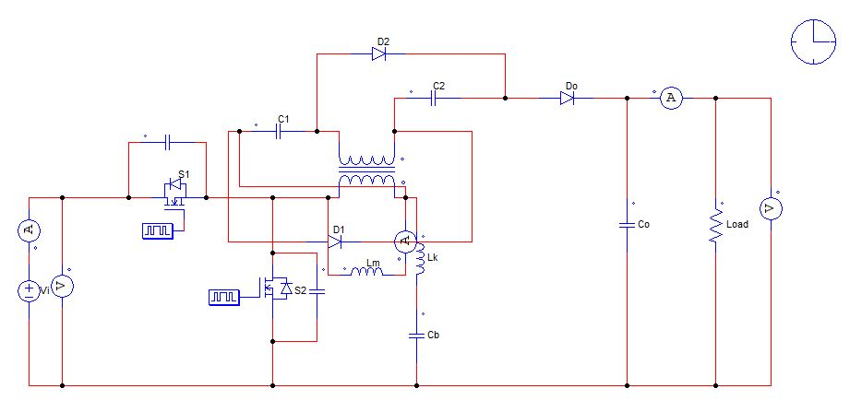
SIMULATION
We are designing the model in PSIM.
PSIM is a powerful circuit simulation tool which allows fast and easy power circuit design verification by simulation.

Slide 16
SIMULATION RESULTS
The results were obtained by simulation at the software PSIM in order to avoid approximate and inaccurate results, such as in the calculation of the rms current values. Two distinct comparisons are performed First, it was considered that both types of converters were designed with the same magnetizing inductance (Lm = 20 μH).
Since the proposed converter has a lower magnetizing ripple which affects the currents throughout the converter, The rms currents were lower in the proposed converter, resulting in much better ratings.
After that, it was considering that both types of converters were designed with the same magnetizing ripple at 50% of duty cycle. Although the results have become closer, the proposed converter still exhibited a lower TDR in almost all the conditions when compared with the Boost-based ones.

Slide 17
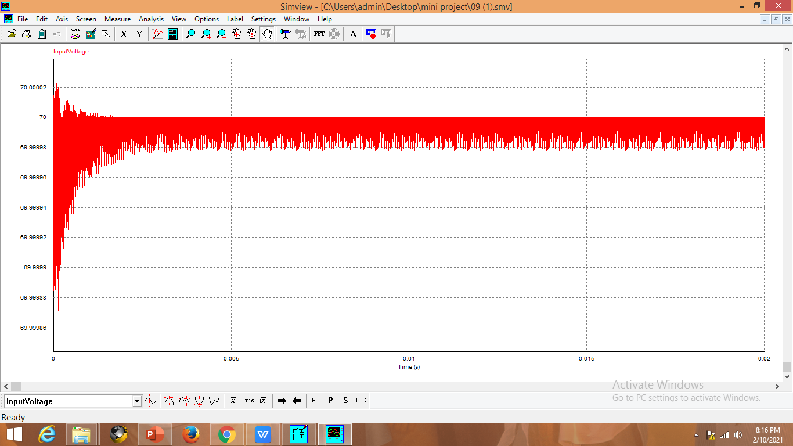
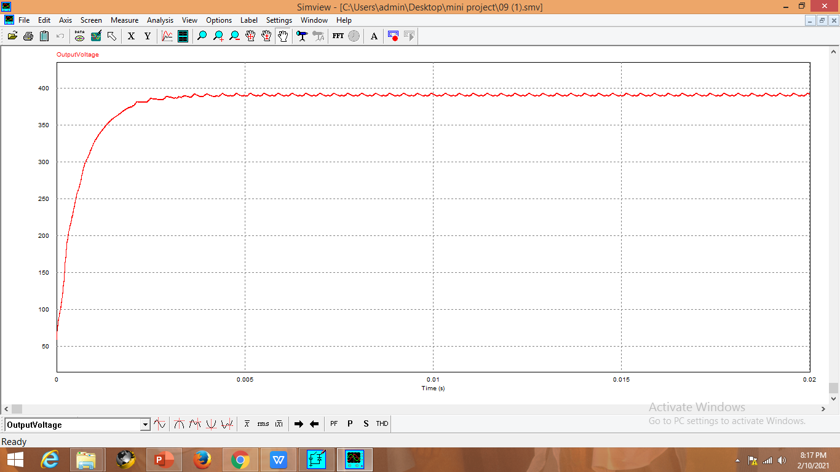
VOLTAGE WAVEFORMS
INPUT VOLTAGE
OUTPUT VOLTAGE

Slide 18

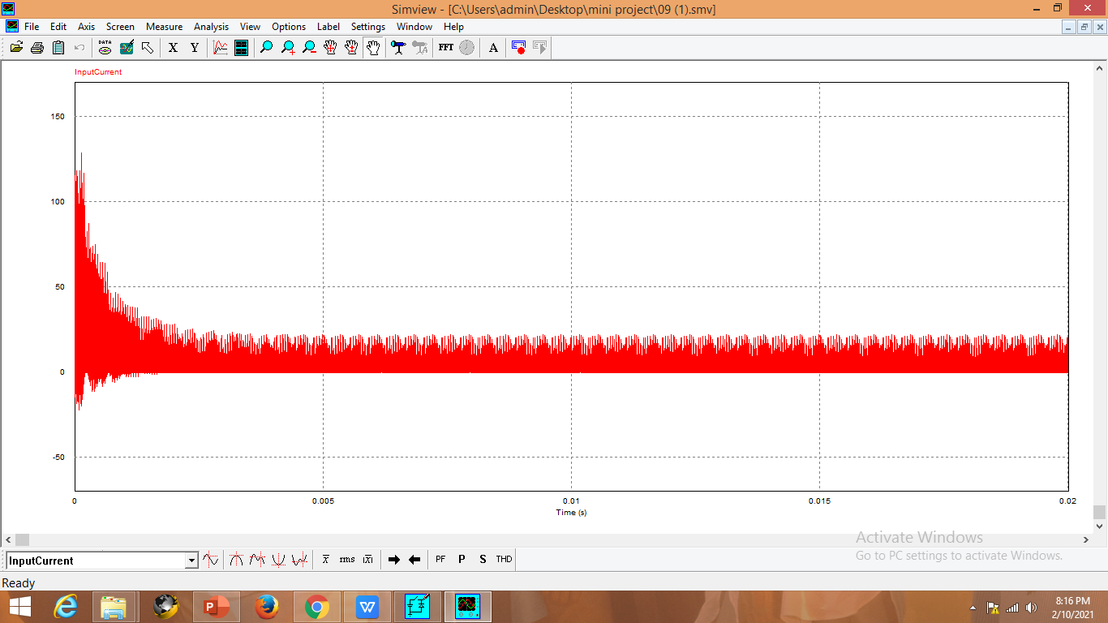
CURRENT WAVEFORMS
INPUT CURRENT
OUTPUT CURRENT

Slide 19
ADVANTAGES
Lower voltage stress over the active switches, allowing the usage of MOSFETs with low voltage rating (≤ 100 V).
Lower total device rating, minimizing the silicon area required to power semiconductor devices
Its coupled inductor requires a lower core-window product, which may lead to a smaller-size and low-profile magnetic device. Furthermore, the proposed converter also shows other important features.

Slide 20
ADVANTAGES
All the devices have voltage clamped properties and their voltage stresses are relatively smaller than the output voltage.
The switches and diodes present soft-switching features, which is helpful for alleviating the switching losses and EMI noises.
The leakage inductor energy of the coupled inductor is recycle, increasing the efficiency and avoiding overvoltage on the switches.
The active switches can efficiently isolate the PV module energy during nonoperation conditions, which enhances safety.

Slide 21
CONCLUSION
A novel non-isolated high step-up dc-dc converter based on the synchronous Buck converter with coupled inductor and voltage multiplier techniques. The converter operates in a resonant manner, which enables the ZVS turn-on of active switches and ZCS turn-off of diodes. In comparison with the widespread high step-up Boost-based converters, the proposed one has lower voltage stress over the active switches, allowing the usage of low voltage power MOSFETs (< 100 V) with better efficiency performance.
In addition, the proposed converter also presents a lower total device rating and requires a coupled inductor with lower core window product, leading to smaller magnetic size. To verify the operation of the proposed converter, a 150-W prototype circuit for PV thin-film module applications with 55-85- V input and 400-V output voltages was simulated and tested.

Slide 22
THANK YOU
PRESENTED BY -G. Sai Ravalika(17831A0214)
-K. Tarun Teja (17831A0219)
-U. Shravanachary (18835A0216)

